Slide 1
ENTERPRISE SERVICE MANAGEMENT
Internal Service Modernization

Slide 2
Agenda
Background & Current-State Findings
New ESM Tool – Key Capabilities
Module Overview
Product Demo (Prototype Walkthrough)
Future Enhancements & Long-Term Roadmap
Build Effort, Team Capacity & Timeline
Q&A / Discussion

Slide 3
Background & Current-State Findings
Fragmented Service Ecosystem - Multiple non-integrated tools cause confusion, duplication, and lack of consolidated ticket visibility.
Incomplete Ticket Information - Users often provide insufficient details causing repeated follow-ups and SLA breaches.
Ineffective Ticket Routing - Lack of seamless ticket escalation leads to broken continuity and lost audit trails.
Dependency on Backend Configuration - Technical interventions for simple changes reduce agility and slow operational improvements.
Offline Critical Conversations - Critical clarifications happen over calls/emails, leading to loss of audit trail, inconsistent updates, and incomplete visibility for stakeholders.
Incorrect Internal Closures - Tickets get closed prematurely when responsibility shifts between internal teams (e.g., website vs. system issues), causing duplicate tickets and fragmented resolution journeys for the user.

Slide 4
Foundational Capabilities
Unified Ticket Management
Configurable Orchestration
End‑to‑end ticket creation, updates, commenting, tracking, and bulk operations for efficient service handling.
Advanced Monitoring & SLA Insights
Dynamic form builder + rule‑based ticket and workflow orchestrators for agile, no‑code changes.
Security & Access Governance
AI‑Driven Ticket Intelligence*
Real‑time dashboards with deep analysis of SLA breaches, bottlenecks, and backlog trends.
Role/Team‑wise access controls, audit trails, and secure integration with internal systems.
Automated Ticketing & Notifications*
Auto‑summaries, detail extraction, similar ticket matching, and guided solution recommendations.
Auto‑creation and reminders triggered via email/MS Teams for seamless request capture.
*Need further detailed research(MVP 3)

Slide 5
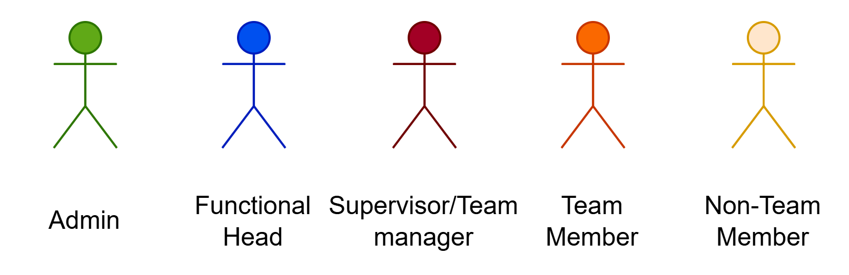
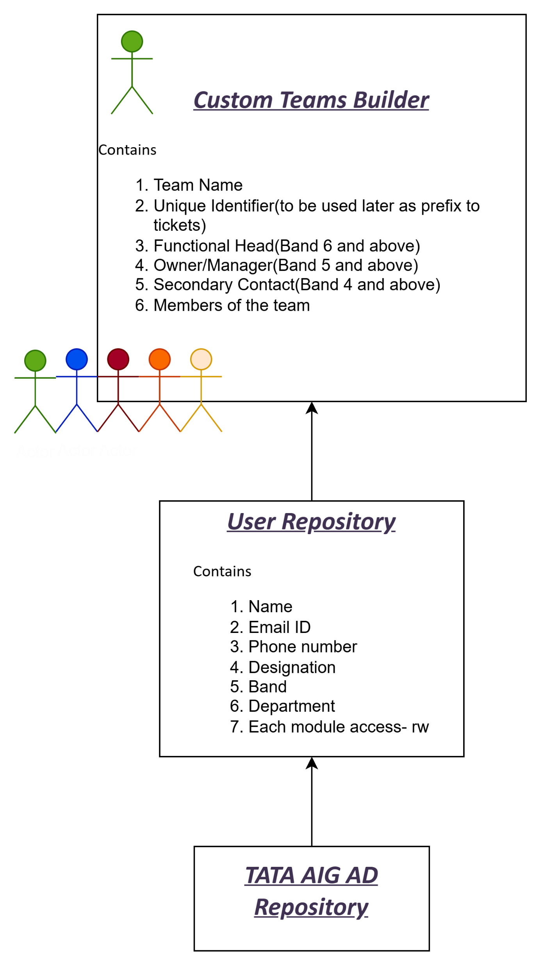
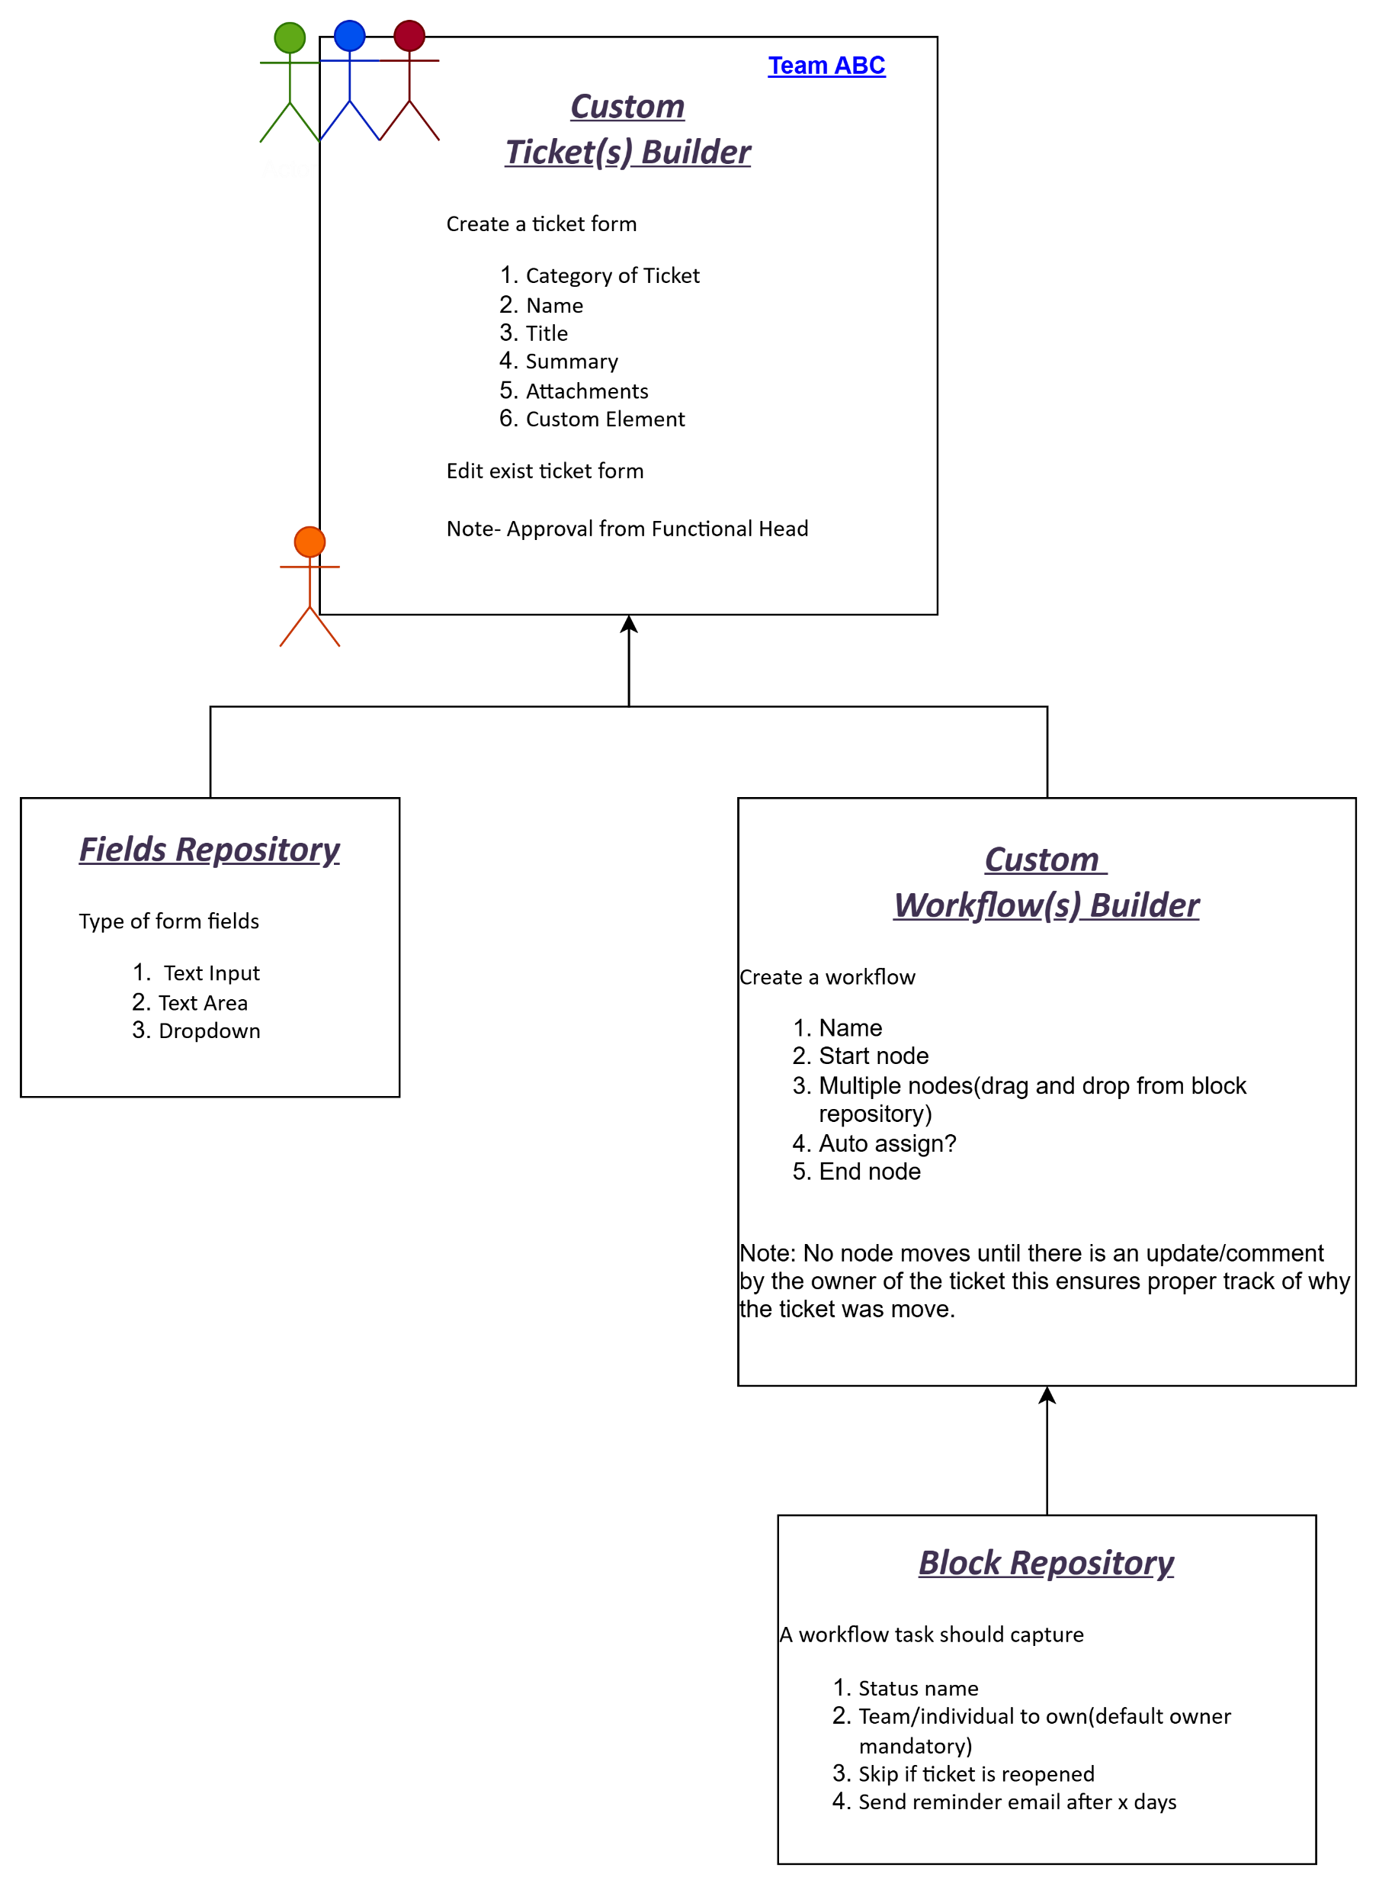
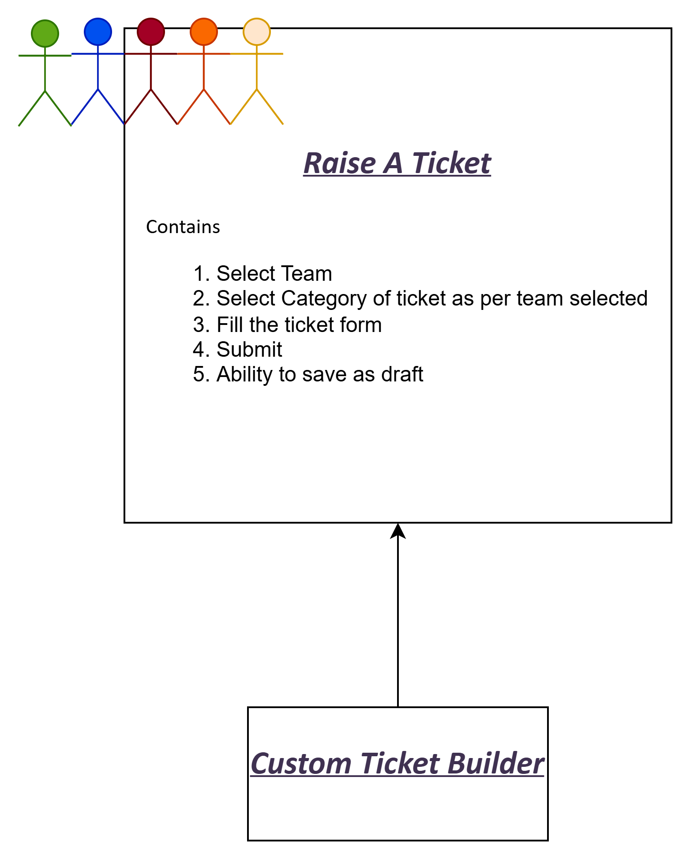
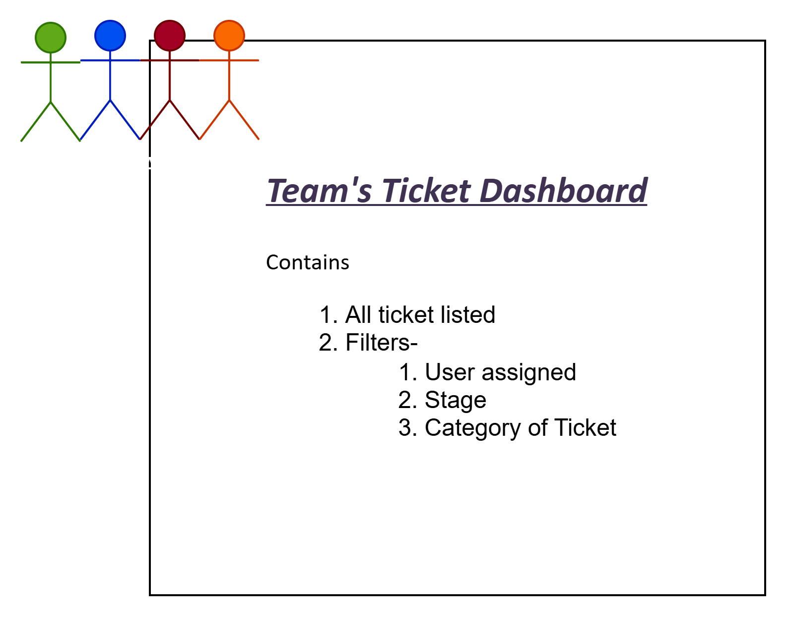
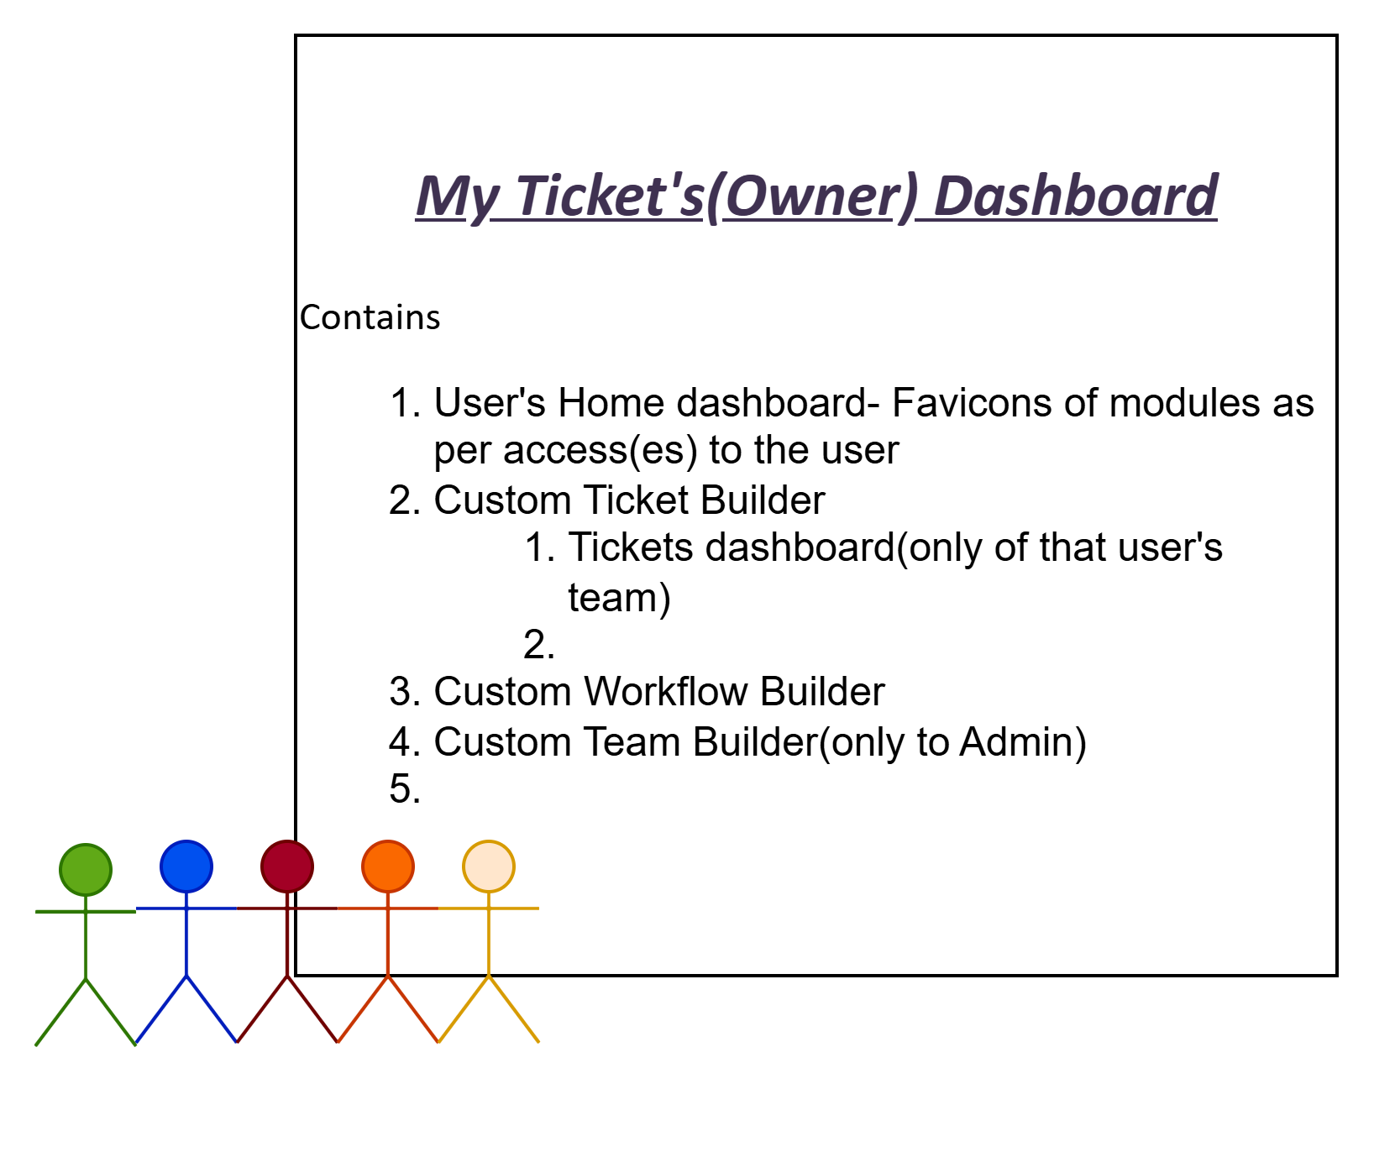
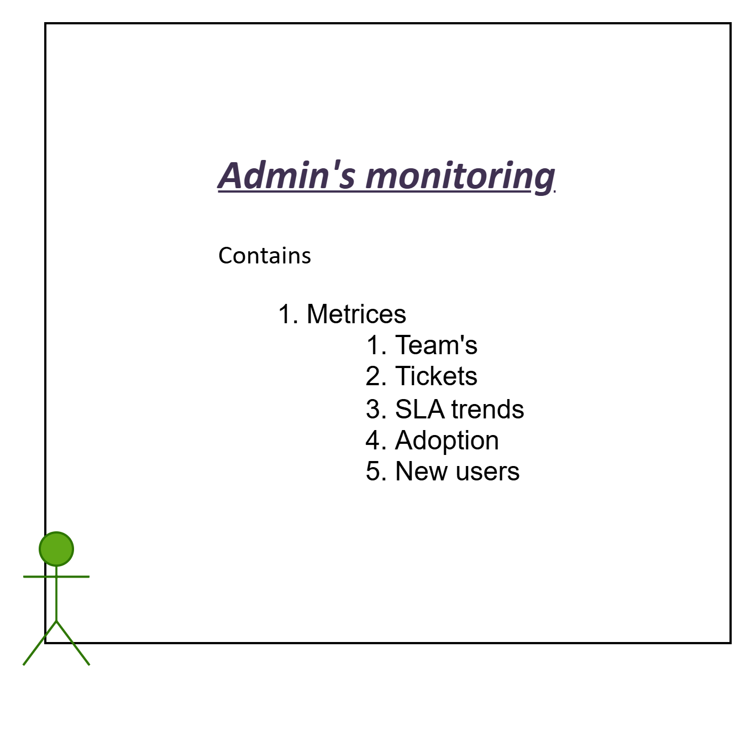
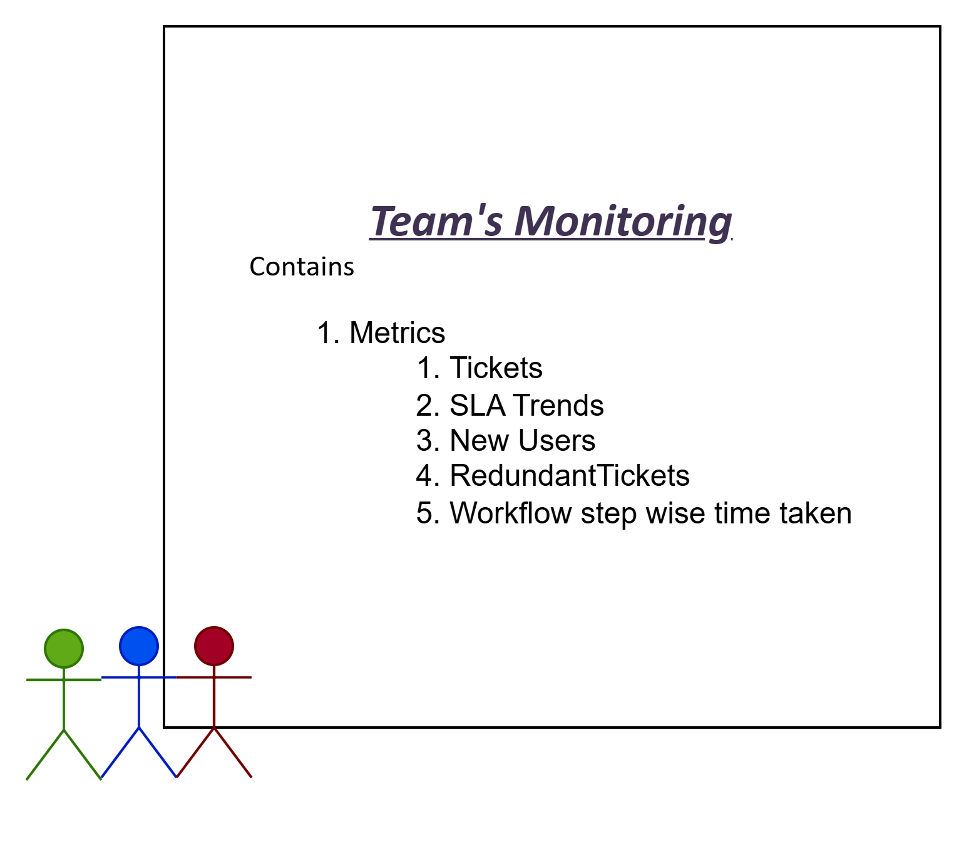
Core ITSM Modules

Slide 6
Screens
# | Navigation From | Screen Name | Contains | Admin | Functional Head | Team Manager/Supervisor | Team Member | Other users
1 |  | Dashboard Default-ESM tool | Raise A Ticket | Y | Y | Y | Y | Y
2 |  |  | Team's Dashboard | Y | Y | Y | Y | Y
3 |  |  | Team's Ticket's Dashboard | Y | Y | Y | Y | N
4 |  |  | Custom Ticket Builder Dashboard | Y | Y | Y | N | N
5 |  |  | My Ticket's Dashboard | Y | Y | Y | Y | Y
6 |  |  | Monitoring | Y | Y | Y | Y | N
7 |  |  | FAQ | Y | Y | Y | Y | Y
8 | Dashboard | Raise A Ticket | Create A Ticket | Y | Y | Y | Y | Y
9 | Dashboard | Team's Dashboard | View Team(s)- owners, description | Y | Y | Y | Y | Y
10 |  |  | Edit Team's structure | Y | Y(O) | Y(O) | N | N
11 |  |  | Delete Team(Archive/Inactive) | Y | Y(O) | Y(O) | N | N
12 |  |  | Create A New Team | Y | Y | N | N | N
13 | Team's Dashboard | Team Details | View Team details | Y | Y | Y | Y | Y
14 |  |  | Edit Team | Y | Y(O) | Y(O) | N | N
15 | Dashboard | Team's Ticket's Dashboard | View Tickets/assigned by/assigned to/stage | Y | Y(O) | Y(O) | Y(M) | N
16 | Team's Ticket Dashboard My Ticket(s) Dashboard | Ticket Details | View Ticket | Y | Y | Y | Y | Y
17 |  |  | Clone Ticket | Y | Y | Y | Y | Y
18 |  |  | Take action(comment/change assignment/change stage) | Y | Y | Y | Y | Y
*(O) represents owner of the department/team

Slide 7
Screens
# | Navigation From | Screen Name | Contains | Admin | Functional Head | Team Manager/Supervisor | Team Member | Other users
19 | Dashboard | Custom Ticket Builder Dashboard | View all ticket(s) form | Y | Y(Team's owned) | Y(Team's owned) | Y(M) | N
20 |  |  | Create A new Ticket form | N | Y(Team's owned) | Y(Team's owned) | N | N
21 |  |  | Edit A Ticket form | N | Y(Team's owned) | Y(Team's owned) | N | N
22 |  |  | Delete Ticket Form(Archive/Inactive) | N | Y(Team's owned) | Y(Team's owned) | N | N
23 | Custom Ticket Builder Dashboard | Ticket Form Details | View Ticket Form | Y | Y(Team's owned) | Y(Team's owned) | Y(M) | N
24 |  |  | Edit Ticket Form | N | Y(Team's owned) | Y(Team's owned) | N | N
25 |  |  | Workflow View | Y | Y(Team's owned) | Y(Team's owned) | Y(M) | N
26 |  |  | Workflow Edit | N | Y(Team's owned) | Y(Team's owned) | N | N
27 | Ticket Form details | Workflow Details | Workflow View | Y | Y(Team's owned) | Y(Team's owned) | Y(M) | N
28 |  |  | Workflow Edit | Y | Y(Team's owned) | Y(Team's owned) | N | N
29 | Dashboard | My Ticket's Dashboard | View Ticket | Y | Y | Y | Y | Y
30 |  |  | Take action(comment/change assignment/change stage) | Y | Y | Y | Y | Y
31 | Dashboard | Monitoring |  | Y | Y | Y | Y | Y
32 | Dashboard | FAQ(s) | View FAQ(s) | Y | Y | Y | Y | Y
*(M) represents member of the team

Slide 8
Prototype demo
Go to ESM Console – Home
Tangible Vision in UI
User Management
Core ITSM Capabilities
Ticket/Workflow Orchestrator
Interactive Live Demo

Slide 9
Future Enhancements
Advanced Workflow Automation
Parallel and conditional workflows enabling complex approval chains and multi-team collaboration without manual steps.
System Integrations
Deeper integration with key platforms within the Ticket to resolve them quicker.
AI-Driven Ticket Resolution
Trained AI agent on historical data to Summarize a ticket and gather relevant information to reduce back and forth.
Redirection between different teams to avoid redundant ticket creation post approval.
Scheduled Reporting
Automatic generation and distribution of operational and SLA reports ensure consistent visibility and reduce manual effort.
Further integration with Outlook and MS Teams for auto ticketing of user queries.
Gather/learn from similar tickets to assist in ticket resolution.
Monitoring
In depth analysis of key metrices for each team with categorization of delay concerns, types of tickets etc.
AI agent to create knowledge base for users to resolve tickets by themselves.

Slide 10
Capacity Estimation(MVP 1)
Epic | Task | Owner | SP(BE) | SP(FE)
Foundations | Create GitHub org & repos | BE | 5 | -
 | CI/CD pipelines (build, test) | BE
 | Infra (Dev/Test) | BE
Platform | Active directory integration | BE | 5 | 3
 | User management- Roles, access(es) | BE
 | FE Integration with AD | FE
Teams | Teams API (members, owners, validation)- DB Structure, CRUD operations | BE | 5 | 3
 | Teams UI (list/edit, add/remove members) | FE
 | Wire FE to Teams API | FE
Ticket Form Builder | Form schema model & storage- JSON schema, conditional fields | BE | 8 | 5
 | Form Builder UI v1- Field palette, properties | FE
 | Render form on Create Ticket | FE
 | FE connects to schema API | BE
Ticket Dashboard | Tickets summary & details API | BE | 8 | 5
 | Ticket UI (list/detail/create) | FE
 | Ticket Details UI | FE
 | Comments & mentions (stub) API | BE
 | Re-assignment/re-routing/stage update APIs | BE
Workflow | Workflow orchestrator(stages, transitions, SLAs)- DB, CRUD APIs | BE | 3 | 5
 | Workflow UI- simple linear design | FE
 | Wire FE to workflow APIs | FE
SLA/Schedulers | SLA breaches and reminders | BE | 3 | 3
 | Reports | FE
Monitoring | Aggregate endpoints | BE | 3 | 3
 | Charts UI (bar/pie) & KPI cards | FE
Dashboard | Role based access | BE | 2 | 3
 | Wire FE to dashboard | BE

Slide 11
ARCHIVE

Slide 12
Foundational Capabilities(Detailed)
Robust Ticket Management – Creation, editing, commenting, tracking, and cross‑team handling of tickets for consistent service delivery.
Monitoring & Dashboards – Real‑time visibility into SLAs, backlog, ageing, and workload for proactive governance.
Security & Integration – Data protection, audit trails, role‑based access, and seamless integration with internal systems.
Bulk Ticket Operations – Bulk upload, updates, transitions, and multi‑select actions to accelerate operations at scale.
Configurable Form Orchestrator – Dynamic form design and updates without backend dependency.
Configurable Ticket Orchestrator – Rule‑based configuration of ticket states, flows, and transitions across service lines.
Team‑wise Role & Access Management – Granular permissions and operational boundaries for teams and functions.
AI‑Driven Ticket Intelligence – Summarizes tickets, extracts missing details, and identifies similar historical cases.
AI‑Powered Resolution Assist – Suggests solutions based on patterns and knowledge repositories to reduce MTTR.
Advanced SLA Analytics – Deep analysis of SLA breaches, bottlenecks, and repeat failure patterns.
Automated Ticketing & Notifications – Auto‑creation of tickets and reminders triggered via email/MS Teams.

